Slide 1




Interfaces and Abstraction
Interfaces vs Abstract Classes Abstraction vs Encapsulation
Java OOP
Basics
SoftUni Team
Technical Trainers
Software University
http://softuni.bg

Slide 2

Table of Contents
Abstraction
Abstraction vs Encapsulation
Interfaces
Interfaces vs Abstract Classes

Slide 3
Questions
sli.do #java-fund

Slide 4
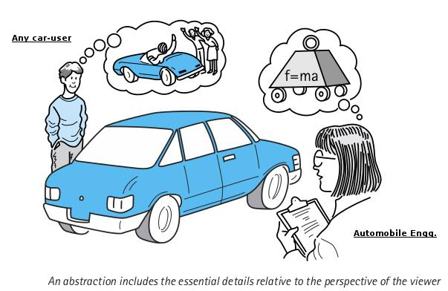
Abstraction

Slide 5
What is Abstraction?
From Latin
Abs
(away from)
Trahere
(to draw)
Abstraction
Process of taking away or removing characteristics from something in order to reduce it to a set of essential characteristics.
Notes:
Polymorphism is the ability of an object to take on many forms. The most common use of polymorphism in OOP occurs when a parent class reference is used to refer to a child class object.

Slide 6

Abstraction in OOP
Abstraction means ignoring irrelevant features, properties, or functions and emphasizing the relevant ones ...
... relevant to the project we develop
Abstraction helps managing complexity
"Relevant" to what?
Notes:
Abstraction means ignoring irrelevant features, properties, or functions and emphasizing the relevant ones, relevant to the project we develop.
Abstraction helps managing complexity
Abstraction is something we do every day:
Looking at an object, we see those things that have meaning to us and ignore all others.
Represent a complex reality with a simplified model.
In a bank application, customers have:
name, phone and address, but they don’t have :
hair color and favorite drink, which we are disregarded from.

Slide 7
Abstraction Example
Abstraction lets you focus on what the object does instead of how it does it.
Notes:
Abstraction means ignoring irrelevant features, properties, or functions and emphasizing the relevant ones, relevant to the project we develop.
Abstraction helps managing complexity
Abstraction is something we do every day:
Looking at an object, we see those things that have meaning to us and ignore all others.
Represent a complex reality with a simplified model.
In a bank application, customers have:
name, phone and address, but they don’t have :
hair color and favorite drink, which we are disregarded from.

Slide 8
How do we achieve abstraction?
There are two ways to achieve abstraction in Java
Interfaces (100% abstraction)
Abstract class (0% - 100% abstraction)
public interface Animal {}
public abstract class Mammal {}
public class Person extends Mammal implements Animal {}
Notes:
There are two ways to achieve abstraction
- Using Abstract Classes
- Using Interfaces

Slide 9
Abstraction vs Encapsulation
Abstraction
Achieved with interfaces and abstract classes
Hiding the implementation details and showing only functionality to the user.
Encapsulation
Achieved with access modifiers (private, public…)
Hiding the code and data in a single unit to protect the data from the outside world
Notes:
There are two ways to achieve abstraction
- Using Abstract Classes
- Using Interfaces

Slide 10
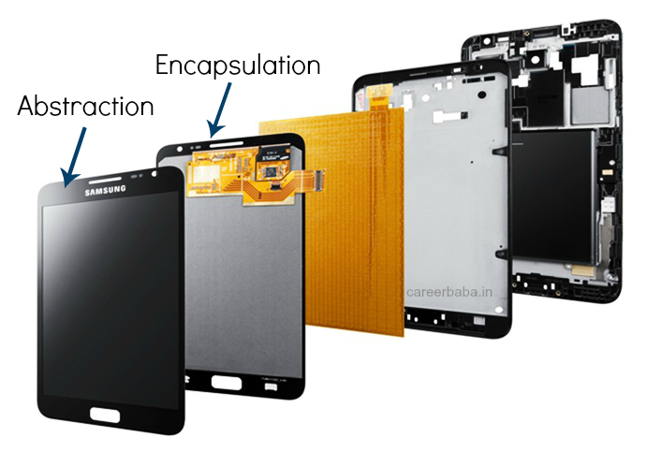
Abstraction vs Encapsulation
Notes:
There are two ways to achieve abstraction
- Using Abstract Classes
- Using Interfaces

Slide 11
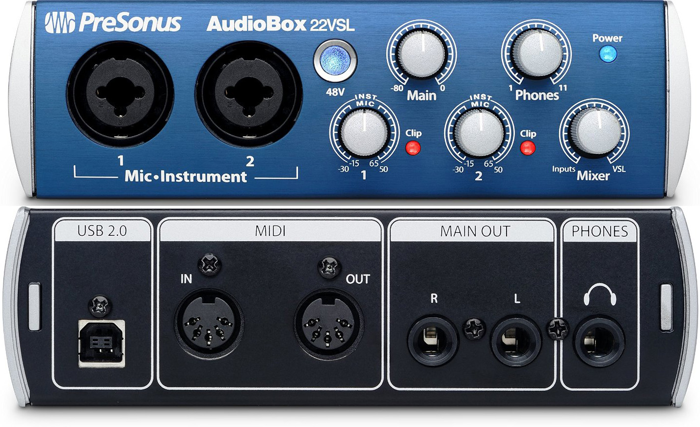
Interface

Slide 12
Interface
Keyword
Internal addition by compiler
public or default modifier
public interface Printable {
int MIN = 5;
void print();
}
Name
compiler
adds public static final before fields
interface Printable {
public static final int MIN = 5;
public abstract void print();
}
public abstract before methods
Notes:
There are two ways to achieve abstraction
- Using Abstract Classes
- Using Interfaces

Slide 13
implements vs extends
Relationship between classes and interfaces
Multiple inheritance
Class
Inteface
Inteface
extends
implements
extends
Class
Class
Inteface
Inteface
Inteface
Inteface
Inteface
implements
extends
Class
Inteface
Notes:
There are two ways to achieve abstraction
- Using Abstract Classes
- Using Interfaces

Slide 14
Interface Example
Implementation of print()is provided in class Document
public interface Printable {
void print();
}
class Document implements Printable {
public void print() { System.out.println("Hello"); }
public static void main(String args[]){
Printable doc = new Document();
doc.print(); }
}
Polymorphism
Notes:
There are two ways to achieve abstraction
- Using Abstract Classes
- Using Interfaces

Slide 15
Problem: Shapes Drawing
Build project that contains interface for drawable objects
Implements two type of shapes: Circle and Rectangle
Both classes have to print on console their shape with "*".
<<interface>>
Drawable
+draw()
<<Drawable>>
Rectangle
<<Drawable>>
Circle
-width: Integer
-height: Integer
-radius: Integer
Notes:
There are two ways to achieve abstraction
- Using Abstract Classes
- Using Interfaces

Slide 16
Solution: Shapes Drawing
public interface Drawable {
void draw();
}
public class Rectangle implements Drawable {
public void draw() { /*draw a rectangle*/}
} //TODO:fields and constructor
public class Circle implements Drawable {
public void draw() { /*draw a circle*/}
} //TODO:fields and constructor
Notes:
There are two ways to achieve abstraction
- Using Abstract Classes
- Using Interfaces

Slide 17
Solution: Shapes Drawing - Rectangle Draw
for (int i = 0; i < this.getHeight(); i++) {
System.out.print("*");
for (int j = 1; j < this.getWidth() - 1; j++) {
System.out.print(" ");
if (i == 0 || i == (this.getHeight() - 1)){
System.out.print("*");
} else { System.out.print(" "); }}
System.out.print(" ");
System.out.print("*");
System.out.println();
}
Notes:
There are two ways to achieve abstraction
- Using Abstract Classes
- Using Interfaces

Slide 18
Solution: Shapes Drawing - Circle Draw
double r_in = this.getRadius() - 0.4;
double r_out = this.getRadius() + 0.4;
for (double y = this.getRadius(); y >= -this.getRadius(); --y) {
for (double x = -this.getRadius(); x < r_out; x += 0.5) {
double value = x * x + y * y;
if (value >= r_in * r_in && value <= r_out * r_out) {
System.out.print("*");
} else
System.out.print(" "); }
System.out.println(); }
Notes:
There are two ways to achieve abstraction
- Using Abstract Classes
- Using Interfaces

Slide 19

Problem: Car Shop
Serializable
Seat
-countryProduced: String
<<interface>>
<<Car>>
+toString(): String
+TIRES: Integer
+getModel()
+getColor()
+getHorsePower()
Notes:
There are two ways to achieve abstraction
- Using Abstract Classes
- Using Interfaces

Slide 20
Solution: Car Shop
public interface Car {
int TIRES = 4;
String getModel();
String getColor();
Integer getHorsePower();
}
Notes:
There are two ways to achieve abstraction
- Using Abstract Classes
- Using Interfaces

Slide 21
Solution: Car Shop
public class Seat implements Car, Serializable {
//TODO: Add fields, constructor and private methods
@Override
public String getModel() { return this.model; }
@Override
public String getColor() { return this.color; }
@Override
public Integer getHorsePower() { return this.horsePower; }
}
Check your solution here: https://judge.softuni.bg/Contests/Practice/Index/1078#0
Notes:
There are two ways to achieve abstraction
- Using Abstract Classes
- Using Interfaces

Slide 22

Interfaces
Live Exercises in Class (Lab)

Slide 23
Extend Interface
Interface can extend another interface
public interface Showable {
void show();
}
public interface Printable extends Showable {
void print();
}
Notes:
There are two ways to achieve abstraction
- Using Abstract Classes
- Using Interfaces

Slide 24
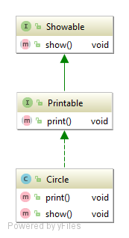
Extend Interface
Class which implements child interface MUST provide implementation for parent interface too
class Circle implements Printable {
public void print() {
System.out.println("Hello");
}
public void show() {
System.out.println("Welcome");
}
Notes:
There are two ways to achieve abstraction
- Using Abstract Classes
- Using Interfaces

Slide 25
Problem: Car Shop Extended
Refactor your first problem code
Add interface for sellable cars
Add interface for rentable cars
Add class Audi, which implements rentable
<<Car>>
+getModel()
+getColor()
+getHorsePower()
<<Rentable>>
<<Sellable>>
+getMinRentDay(): Integer
+getPricePerDay(): Double
+getPrice(): Double
Notes:
There are two ways to achieve abstraction
- Using Abstract Classes
- Using Interfaces

Slide 26
Solution: Car Shop Extended
public interface Sellable extends Car {
Double getPrice();
}
public interface Rentable extends Car{
Integer getMinRentDay();
Double getPricePerDay();
}
Check your solution here: https://judge.softuni.bg/Contests/Practice/Index/1078#1
Notes:
There are two ways to achieve abstraction
- Using Abstract Classes
- Using Interfaces

Slide 27
Solution: Car Shop Extended
public class Audi implements Rentable {
public String getModel() { return this.model; }
public String getColor() { return this.color; }
public int getHorsePower() { return this.horsePower; }
public Integer getMinRentDay() {
return this.minDaysForRent; }
public Double getPricePerDay() {
return this.pricePerDay; }
}
Check your solution here: https://judge.softuni.bg/Contests/Practice/Index/1078#1
Notes:
There are two ways to achieve abstraction
- Using Abstract Classes
- Using Interfaces

Slide 28
Default Method
Since Java 8 we can have method body in the interface
If you need to Override default method think about your design
public interface Drawable {
void draw();
default void msg() {
System.out.println("default method:")
}
}
Notes:
There are two ways to achieve abstraction
- Using Abstract Classes
- Using Interfaces

Slide 29
Default Method
Implementation is not needed for default methods
class TestInterfaceDefault {
public static void main(String args[]) {
Drawable d=new Rectangle();
d.draw(); //drawing rectangle
d.msg(); //default method
}
}
Notes:
There are two ways to achieve abstraction
- Using Abstract Classes
- Using Interfaces

Slide 30
Static Method
Since Java 8, we can have static method in interface
public interface Drawable {
void draw();
static int cube(int x) { return x*x*x; }
}
public static void main(String args[]){
Drawable d = new Rectangle();
d.draw();
System.out.println(Drawable.cube(3));} //27
Notes:
There are two ways to achieve abstraction
- Using Abstract Classes
- Using Interfaces

Slide 31
Problem: Say Hello
Design a project, which has:
Interface for Person
Three implementation for different nationalities
Override where needed
<<interface>>
<<Person>>
+getName(): String
+sayHello()
<<Person>>
European
<<Person>>
Bulgarian
<<Person>>
Chinese
-name: String
-name: String
-name: String
+sayHello(): String
+sayHello(): String
Notes:
There are two ways to achieve abstraction
- Using Abstract Classes
- Using Interfaces

Slide 32
Solution: Say Hello
public interface Person {
String getName();
default void sayHello() { System.out.println("Hello");} }
public class European implements Person{
private String name;
public European(String name) { this.name = name; }
public String getName() { return this.name; }
}
Check your solution here: https://judge.softuni.bg/Contests/Practice/Index/1078#2
Notes:
There are two ways to achieve abstraction
- Using Abstract Classes
- Using Interfaces

Slide 33
Solution: Say Hello
public class Bulgarian implements Person {
private String name;
public Bulgarian(String name) {
this.name = name;
}
public String getName() { return this.name; }
public void sayHello() {System.out.println("Здравей");}
}
//TODO: Do the same for Chinese
Check your solution here: https://judge.softuni.bg/Contests/Practice/Index/1078#2
Notes:
There are two ways to achieve abstraction
- Using Abstract Classes
- Using Interfaces

Slide 34
Interface vs Abstract Class
Abstract Class
Doesn't support multiple inheritance.
Can have abstract and non-abstract methods.
Can have final, non-final, static and non-static variables.
Interface
Supports multiple inheritance.
Can have only abstract, default and static methods.
Can have only static and final variables.
Notes:
There are two ways to achieve abstraction
- Using Abstract Classes
- Using Interfaces

Slide 35
Problem: Say Hello Extended
Refactor the code from the last problem
Add BasePerson abstract class
Move in it all code duplication from European, Bulgarian, Chinese
BasePerson
-name: String
-setName(): void
Notes:
Java interfaces are like purely abstract classes, but:
- All interface methods are abstract
- Interface members do not have scope modifiers
- Their scope is assumed public
- But public is not specified explicitly
- Cannot define fields, inner types and constructors

Slide 36
Solution: Say Hello Extended
public abstract class BasePerson implements Person{
private String name;
protected BasePerson(String name) {
this.setName(name);
}
private void setName(String name) {
this.name = name;
}
@Override
public String getName() {
return this.name;
} }
Check your solution here: https://judge.softuni.bg/Contests/Practice/Index/1078#3
Notes:
There are two ways to achieve abstraction
- Using Abstract Classes
- Using Interfaces

Slide 37
Interfaces and Abstract Class
Live Exercises in Class (Lab)

Slide 38
Summary
Abstraction
Interface
Implements vs Extends
Default and Static methods
Interface vs Abstract Class
Notes:
Abstraction :
Models class behavior
Interfaces :
Define a set of methods (contracts)
Abstract classes :
Mixes between class and interface

Slide 39












Java Advanced – Course Overview
https://softuni.bg/courses/java-oop-basics

Slide 40





Trainings @ Software University (SoftUni)
Software University – High-Quality Education, Profession and Job for Software Developers
softuni.bg
Software University Foundation
http://softuni.foundation/
Software University @ Facebook
facebook.com/SoftwareUniversity
Software University Forums
forum.softuni.bg

Slide 41
License
This course (slides, examples, demos, videos, homework, etc.) is licensed under the "Creative Commons Attribution-NonCommercial-ShareAlike 4.0 International" license
Attribution: this work may contain portions from
"Fundamentals of Computer Programming with Java" book by Svetlin Nakov & Co. under CC-BY-SA license
"OOP" course by Telerik Academy under CC-BY-NC-SA license

